Slide 1
ARDUINO BASED AUTOMATIC WATER TAP
Submitted by
18101009 HASAN TAHSIN RAFSAN
18101014 MD. EFTI KHAIRUL ALAM
18101025 TANVEER AHAMMED RABBY
Group no: 5
submitted to
Abdullah al omar
Lecturer, cse
University of asia pacific

Slide 2
MOTIVATION
Nowadays COVID-19 spread out through the world massively. To maintain safety standards we all need to wash our hands very often. But in public places, we don’t find any system where we can wash our hands “safely” without touching the taps. As we see in public places, there are some mobile toilets, where the hand washing system is unhygienic. So, we want to design an Automated touchless water tap system by using Arduino in our project.

Slide 3
OBJECTIVES
The goal of the project is using a Servo motor to operate the water tap. First we read the distance from the ultrasonic sensor to the hand with the help of Arduino UNO. If the distance is less than 20 cm, the servo motor will turn on and start the water flow. Otherwise the servo motor is turned off.

Slide 4
COMPONENTS
Arduino Uno
Servo Motor 9G
HC-SR04 Ultrasonic/Ultrasound Sensor
Water Tap
Jumper (Male to Male, Male to Female)
Wire

Slide 5
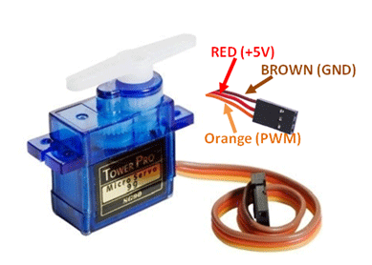
COMPONENTS Servo Motor 9G

Slide 6
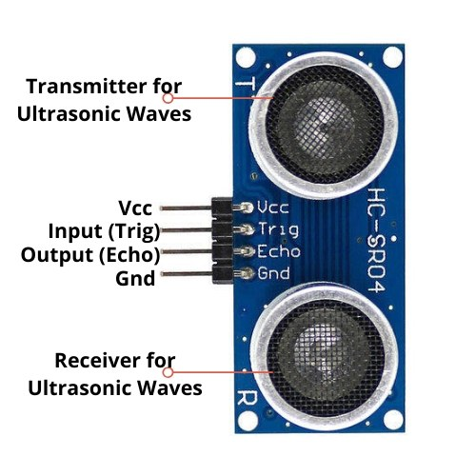
COMPONENTS Ultrasonic Sensor

Slide 7
CODE
Slice 1 | Slice 2
#include<Servo.h> #define trigPin 4 #define echoPin 5 Servo Myservo; | void setup() { Serial.begin(9600); pinMode(trigPin, OUTPUT); pinMode(echoPin, INPUT); Myservo.attach(3); }
Slice 3 | Slice 4
void loop() { long duration, distance; digitalWrite(trigPin, LOW); delayMicroseconds (2); digitalWrite (trigPin, HIGH); delayMicroseconds (10); digitalWrite(trigPin, LOW); duration = pulseIn (echoPin, HIGH); distance=(duration*0.034/2); | if(distance<20){ Serial.println("distance less than 20 cm"); Myservo.write(90); } else{ Serial.println("distance greater than 20 cm"); Myservo.write(0); } delay(500); }

Slide 8
THANK YOU

